Slide 1


FLIPKART AIR CONDITIONER DATA ANALYSIS
Presented by:
MANGALI DEEPIKA
MUNIPAVANI ANGADALA

Slide 2

INTRODUCTION
Project focuses on analysing Air Conditioner (AC) data collected from Flipkart.
Helps understand pricing trends, brand popularity, energy ratings and capacity distribution.
Data collected using web scraping and analysed through Python-based EDA.
Aims to convert unstructured website data into useful business insights.
Demonstrates complete data analysis workflow —
Collection → Cleaning → Visualization → Insights.

Slide 3
BUSINESS PROBLEM
Flipkart lists hundreds of ACs from multiple brands with different prices and features.
Customers face difficulty in selecting the best value-for-money product.
Sellers and brands need data-driven insights about customer preferences and pricing trends.
Lack of structured data analysis leads to confusion and poor marketing focus.
Project aims to bridge this gap by using data analytics for better decision-making.

Slide 4
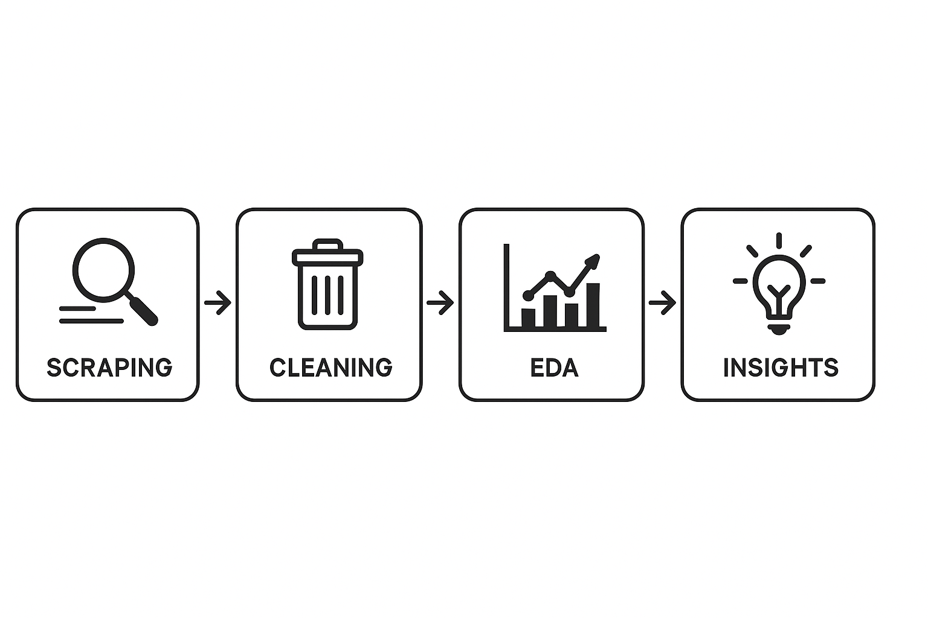
OBJECTIVE
Collect and analyse Flipkart AC product data.
Identify popular brands, capacity sizes, and energy ratings.
Understand how price and ratings vary across categories.
Discover customer preferences and market gaps.
Provide recommendations to buyers and sellers for better decision-making.

Slide 5
TOOLS USED
This project was implemented using Python and several powerful open-source libraries for data collection, cleaning, and analysis.
Python : The main programming language used for web scraping and EDA.
Pandas & NumPy : For data manipulation, transformation, and handling missing values.
BeautifulSoup : Used for web scraping product details from Flipkart such as brand, price, capacity, ratings, and energy star information.
Matplotlib & Seaborn : For data visualization — creating bar charts, scatter plots, histograms, and heatmaps.
Jupyter Notebook : Development environment to execute and document the code. These tools made it possible to process unstructured website data into structured datasets and create clear visual insights.

Slide 6
Web Scraping Process
The dataset was generated through web scraping from the Flipkart e-commerce website.
Extracted data from Flipkart AC product pages.
Scraped details: brand, model name, price, capacity, energy rating, type, reviews, features, and warranty.
Handled multiple pages using pagination.
Added headers and small delays to avoid being blocked.
Saved all data in a CSV file for further cleaning.

Slide 7
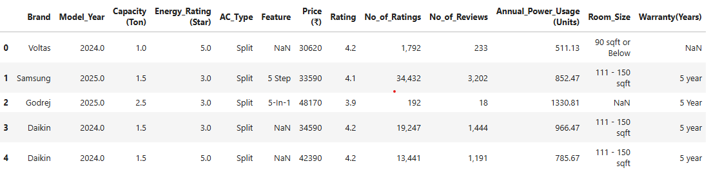
Preview of Dataset

Slide 8
DATA CLEANING STEPS
Loaded raw dataset and inspected missing values.
Removed duplicates and irrelevant columns.
Handled missing values with median/mode imputation.
Converted “Price” column from ₹ strings to numeric.
Cleaned columns like “Capacity” (Ton) and “Energy_Rating (Star)”.
Removed special symbols (₹, %, commas).

Slide 9
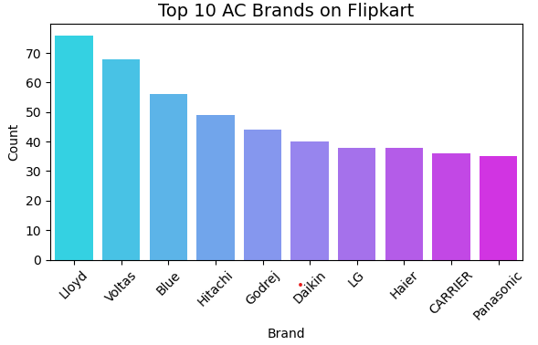
DATA VISUALIZATION
UNIVARIATE ANALYSIS
Visualization – Top Brands
Type: Bar Chart Insight: LG, Voltas, Samsung, and Daikin have the highest number of AC models on Flipkart.
These brands dominate the online market and have wide model variety.
Helps identify brand availability and competition.
Indicates market dominance by a few key players.
Useful for sellers to benchmark brand presence.

Slide 10
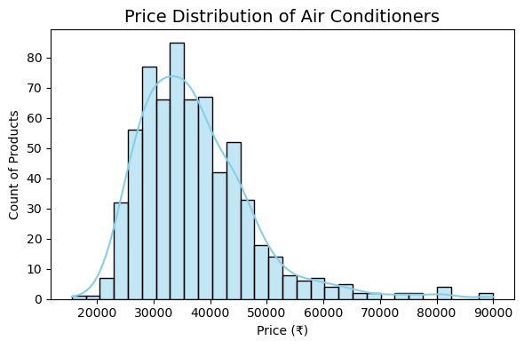
DATA VISUALIZATION
Visualization – Price Distribution
Type: Histogram Insight: Most ACs are priced between ₹25,000–₹45,000. Very few models fall above ₹60,000 or below ₹20,000.
Reveals mid-range products dominate the market.
Price distribution is right-skewed, meaning fewer premium models.
Indicates customer preference for affordable ACs.

Slide 11
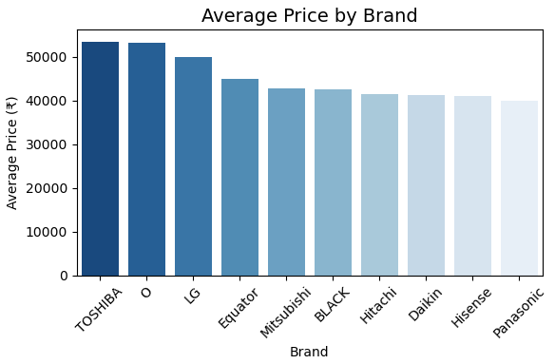
BIVARIATE ANALYSIS
Visualization – Average Price by Brand
Type: Bar Chart Insight: Daikin and LG have the highest average prices, while Voltas and Whirlpool are more budget-friendly.
Additional Points:
Highlights brand positioning — premium vs budget.
Shows pricing strategy differences among manufacturers.
Buyers can compare brands based on price expectations.

Slide 12
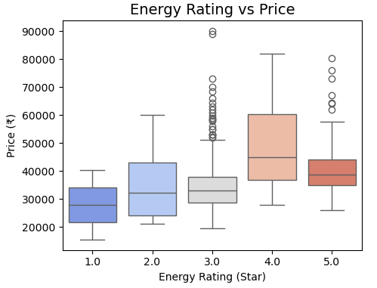
Visualization – Energy Rating vs Price (Box Plot)
Type: Box Plot Insight: Higher energy ratings (4-star, 5-star) are generally costlier. Shows customers are willing to pay more for better energy efficiency.
Additional Points:
Displays price variation within each star category.
5-star models have a higher median price.
Confirms energy-saving models are premium products.

Slide 13
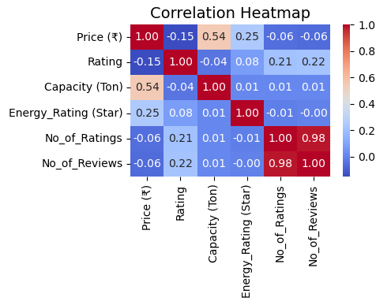
MULTIVARIATE ANALYSIS
Visualization – Correlation Heatmap
Type: Heatmap Insight: Shows relationships between numeric variables such as Price, Rating, Capacity, and Energy Star. There is a mild correlation between Energy Rating and Price, and a weak correlation between Price and Customer Rating.
Additional Points:
Helps detect hidden relationships among variables.
Useful for understanding factors influencing price.
Confirms ratings depend more on quality and service than on cost or capacity.

Slide 14
CONCLUSION
Project provided detailed insights from real Flipkart AC data.
Majority of ACs fall in ₹25K–₹45K range and are 1.5 Ton Split ACs.
Customers prefer energy-efficient (4–5 Star) inverter models.
LG, Voltas, and Samsung are top-performing brands.
Price and customer rating show weak correlation — value and features matter more.
Helps buyers choose wisely and sellers optimize product strategy.

Slide 15
Key Insights
Mid-range ACs are most demanded.
1.5 Ton capacity dominates.
High energy star models cost more but sell well.
Split ACs preferred for performance and design.
Challenges
Dynamic Flipkart pages caused scraping issues.
Missing data and inconsistent text formatting.
Cleaning special symbols like ₹ and % required careful handling.

Slide 16
Insights and Findings
Most Popular Brands: LG, Samsung, Voltas, Daikin.
Average Price Range: ₹30,000 – ₹45,000 for mid-range models.
Top Selling Type: Split ACs with 1.5 Ton capacity.
Ratings: Most ACs have ratings between 4.0 and 4.5.
Conclusion
Successfully analysed Flipkart AC data using Python.
Identified trends in pricing, brands, and energy ratings.
Created meaningful insights for better product selection.
Learned web scraping, data cleaning, and visualization end-to-end.

Slide 17

THANK YOU

